Slide 1
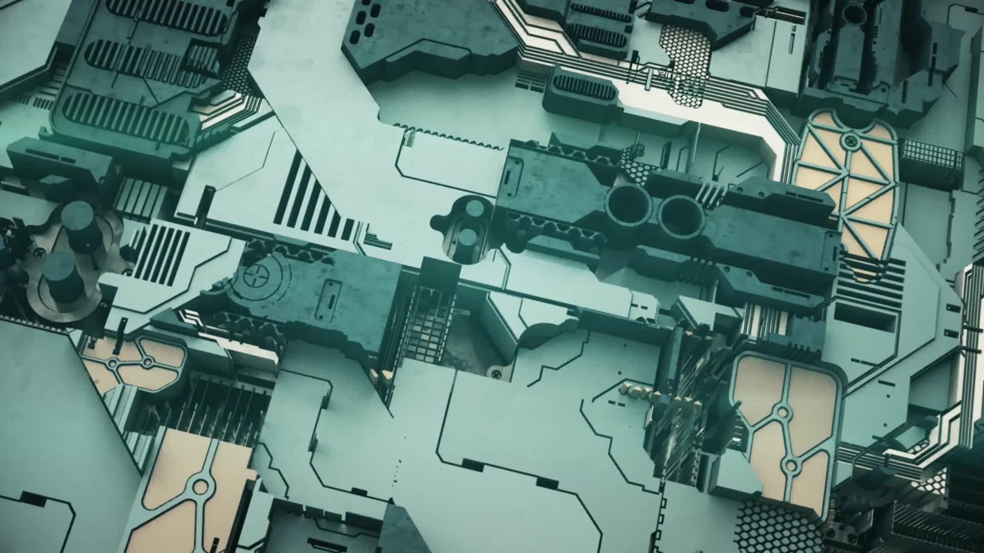
Generating Synthetic Video Data to Train Fall Detection Models
Generating Synthetic Video Data to Train Fall Detection Models
Module
MSc Artificial Intelligence and Robotics Project
Name
Sathishkumar Palanikumar
SRN
22081990
supervisor
Dr. Na Helian
University of Hertfordshire

Slide 2
Problem Statement
Falls among the elderly pose serious health risks.
Challenges in real-world fall data collection:
Ethical concerns
Logistical challenges
Limited dataset diversity
Need for innovative solutions to improve dataset availability.

Slide 3
Objectives
Develop a scalable framework for synthetic video generation using Unity.
Automate the creation of diverse fall scenarios:
Vary avatars, camera angles, and lighting conditions.
Evaluate the applicability of synthetic datasets for fall detection models.

Slide 4


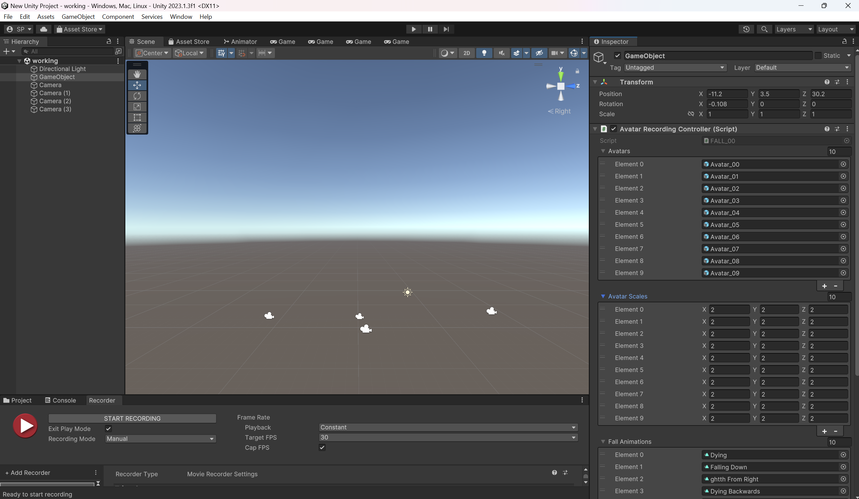
Methodology Overview
Tool: Unity 2023.1.3f1
Steps:
Environment setup with minimal distractions.
Diverse avatars and realistic fall animations.
Multi-camera setup for varied perspectives.
Automation scripts for scalable video generation.
Output:
Synthetic video dataset simulating 400 fall scenarios.

Slide 5
Methodology Overview
Tool: Unity 2023.1.3f1
Steps:
Environment setup with minimal distractions.
Diverse avatars and realistic fall animations.
Multi-camera setup for varied perspectives.
Automation scripts for scalable video generation.
Output:
Synthetic video dataset simulating 400 fall scenarios.

Slide 6

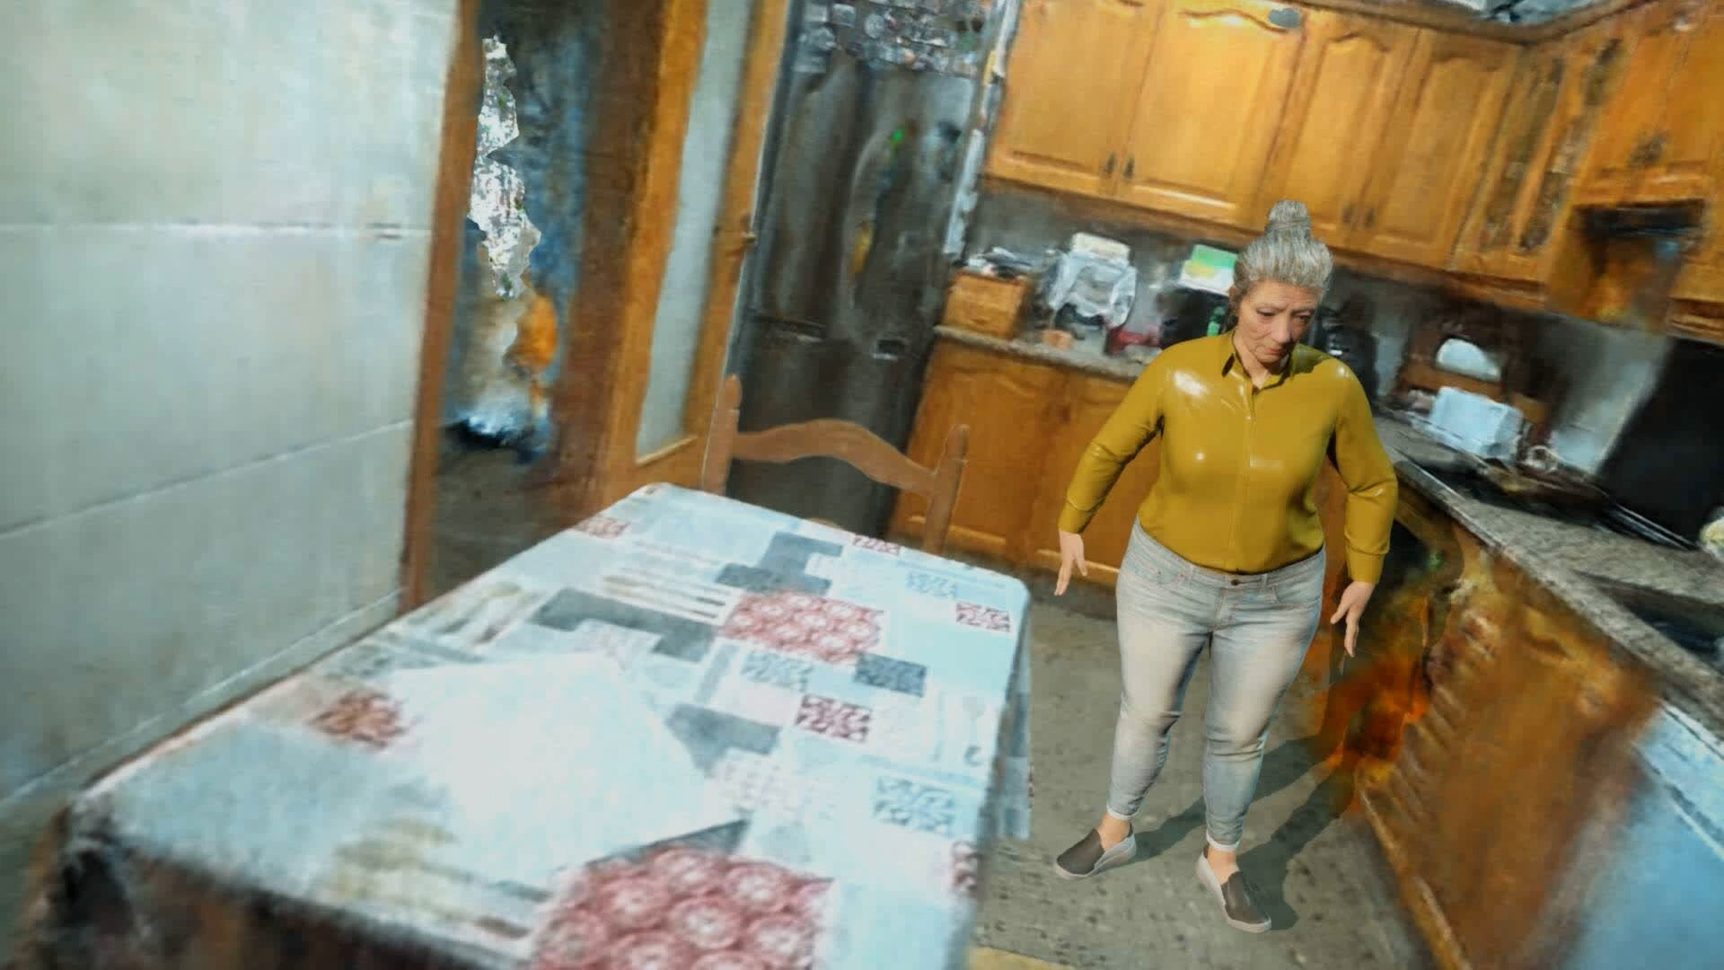
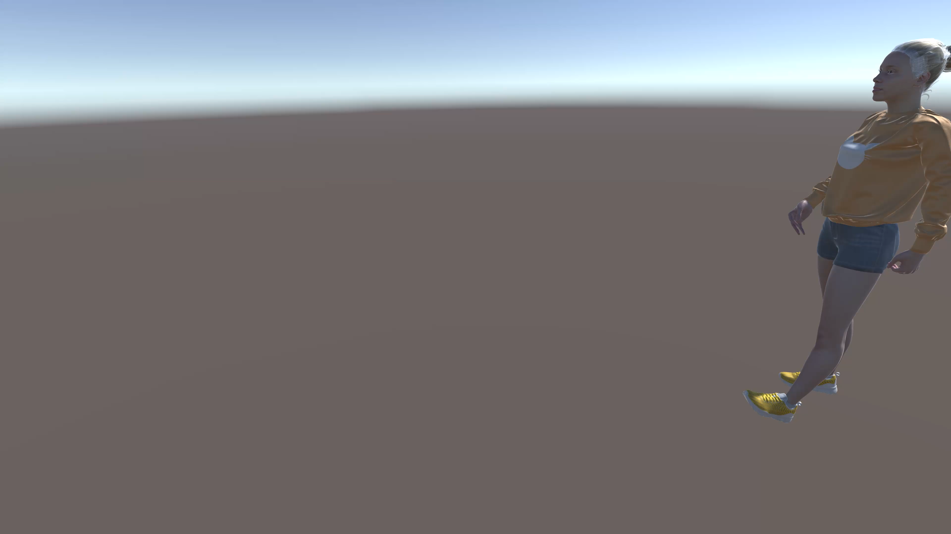
Existing Models Comparison
UnrealFall Project:
Uses Unreal Engine to generate synthetic videos.
Videos include incomplete falls with avatars moving forward or backward after half-falls.
High complexity in setup and operation.
Current Project (Unity-based):
Generates proper and realistic fall scenarios.
Simplified framework with easier setup and use.
Improved fall dynamics ensuring accurate motion representation.

Slide 7
Results
Training Results
Experiment | Synthetic Data (%) | Real-World Data (%) | Accuracy (Mean ± SD) | F1-Score (Mean ± SD) | Best Model Accuracy | Best Model F1-Score
Experiment 1 | 0% | 100% | 0.9646 ± 0.0216 | 0.9636 ± 0.0260 | 0.9837 | 0.9846
Experiment 2 | 25% | 100% | 0.9675 ± 0.0204 | 0.9752 ± 0.0163 | 0.9901 | 0.9925
Experiment 3 | 50% | 100% | 0.9733 ± 0.0170 | 0.9820 ± 0.0115 | 0.9935 | 0.9958
Experiment 4 | 100% | 100% | 0.9704 ± 0.0327 | 0.9817 ± 0.0218 | 0.9951 | 0.9969

Slide 8
Testing Results
Experiment | Accuracy | F1-Score | Precision | Recall | Specificity
Experiment 1 | 0.9685 | 0.2868 | 0.1679 | 0.9818 | 0.9684
Experiment 2 | 0.9646 | 0.2630 | 0.1519 | 0.9792 | 0.9645
Experiment 3 | 0.9762 | 0.3409 | 0.2075 | 0.9557 | 0.9763
Experiment 4 | 0.9395 | 0.1731 | 0.0949 | 0.9818 | 0.9392

Slide 9
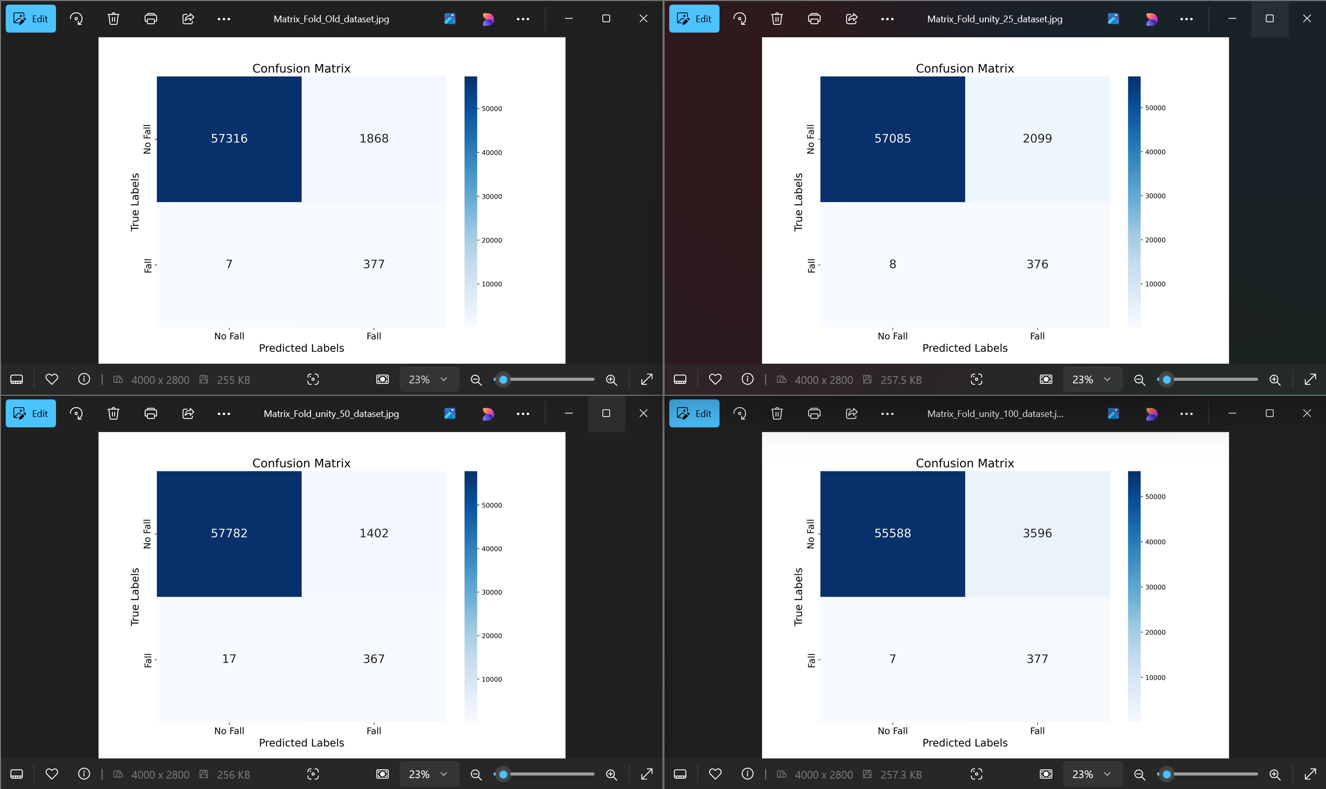
Confusion Matrix Results

Slide 10
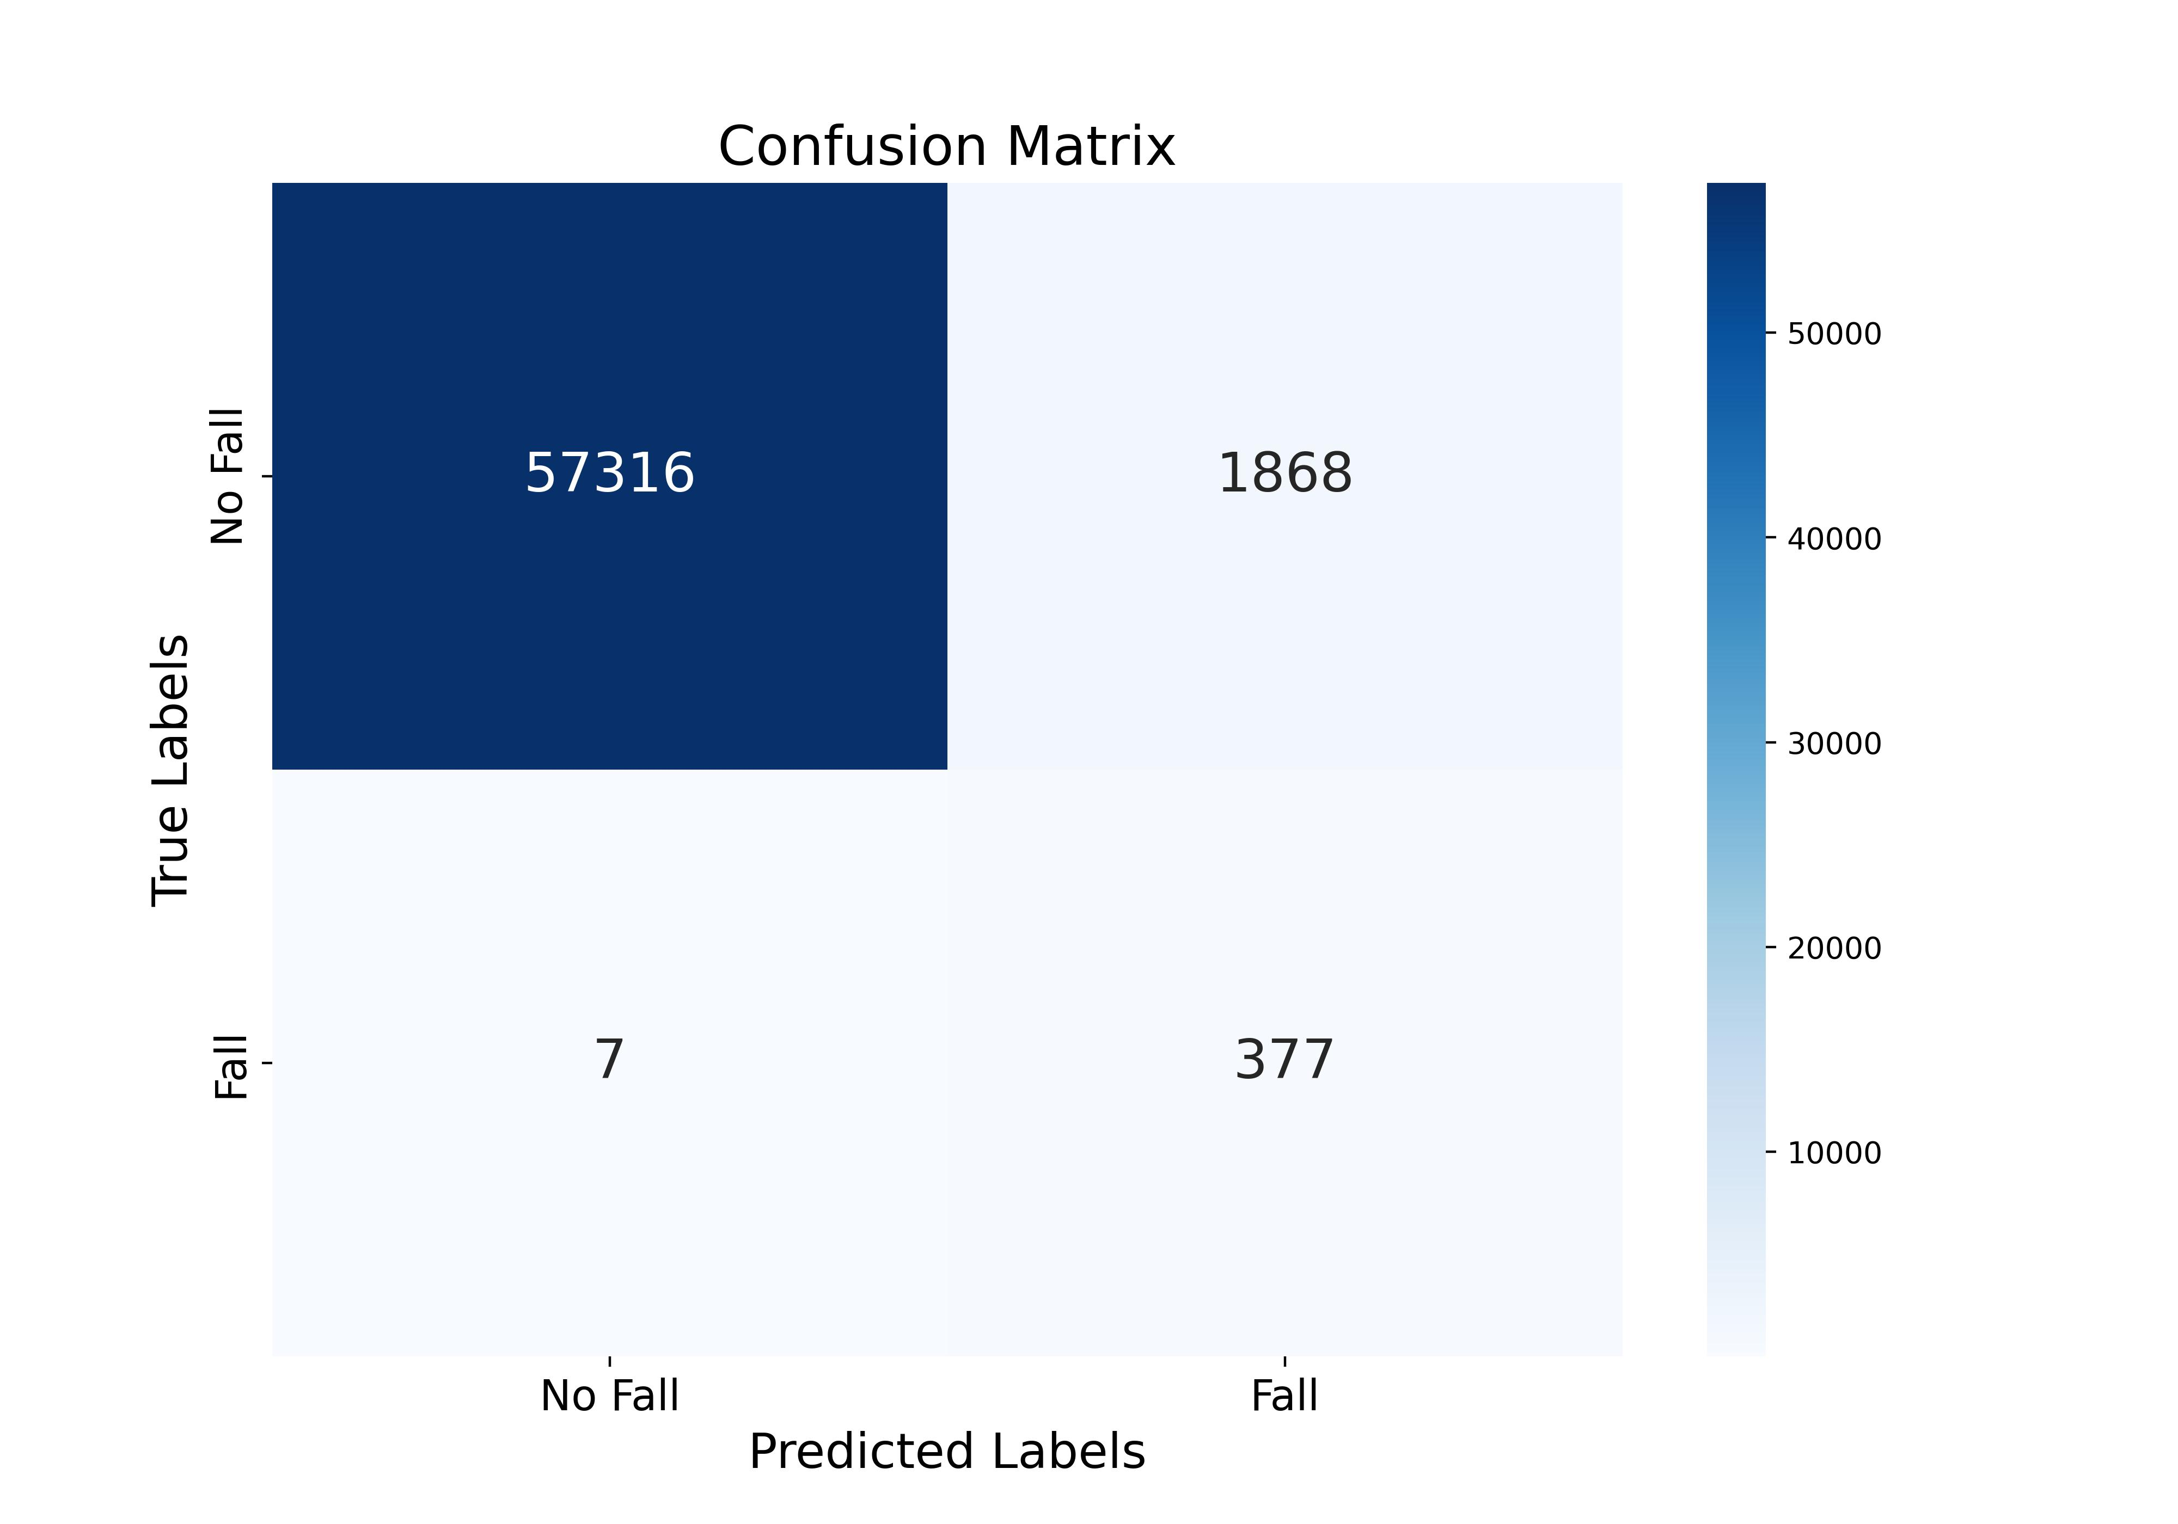
Real-Data
Confusion Matrix Results

Slide 11

25%synthetic data
Confusion Matrix Results

Slide 12

50%synthetic data
Confusion Matrix Results

Slide 13

Confusion Matrix Results
100%synthetic data

Slide 14
Conclusion:
Synthetic data bridges gaps in dataset availability for fall detection.
Enhances performance metrics for machine learning models.
Paves the way for scalable, cost-effective, and ethical solutions in healthcare.
Future Work:
Expand scenarios to include:
Outdoor environments
Multi-person interactions
Complex object interactions.
Automate video generation pipeline fully.
Validate in real-world settings and test real-time detection.

Slide 15

QAQ

